Slide 1

Email Automation Using Blue Prism
Project Supervisor: Dr. T. Prem Jacob
Name of the Student: Mr. Yarram Abhilash Reddy
Register Number: 39111124

Slide 2
Presentation Outline
Course Certificate
Introduction
Objectives
System Architecture / Ideation Map
Module Implementation
Application Snapshots
Results and Discussions
Conclusion & Future work
References

Slide 3
Course Certificate
Attach your Course Certificate here

Slide 4

Introduction
Robotic Process Automation (RPA) is one of the most trending technologies in IT field. There was an rapid adoption of RPA across various industries. This course is easy to learn and implement. It produce the correct result without any deviation. This make me interest to learn this course and do project in this course.
To create a bot that automatically send emails with attachment to a list of people.
The main objective behind this is to get familiar with MS EXCEL VBO and EMAIL SMTP and send emails with attachment to bunch of people.

Slide 5
Objectives
Project Objective:
To gain insights into building blocks of blue prism automation.
Importing MS EXCEL VBO and EMAIL SMTP (Visual basic for applications) in Blue prism.
Tuning process studio with specific needs and working with different stages in process studio.
Finally building a bot that automatically send mails with attachments to a list of people with the help of Microsoft Excel 2013 and Blue prism.
Scope of the Project:
In each and every Industry, while they are going to conduct workshops, competitions etc . It is necessary to send bulk certificates to candidates that to with specific certificates for a specific candidate.

Slide 6
We use Blue Prism tool to work with this Email automation. We will know how to import MS excel VBO and Email SMTP in this software . We will know how this RPA techniqe has been implemented in a simple way.
Ways to achieve project objectives :
There are number of ways to achieve the objectives,now we are using Blue prism tool.
-we have to configure the process model by importing ms excel VBO and email vbo ,then the process model has to be binded with ms excel vbo and email vbo.
-we have to add the following stages into our process flow
(1)Create instance (2) open Excel file (3) Getting email ID’s (4)Closing Excel file (5) configuring email (6) Fetching attachments and sending mails.
- our way of implementing must be clear and effective. So that it will be easy. When communicating through email, always be specific with what you’re talking about.Email is a computerized system for sending digital messages from one member to more than one member.

Slide 7
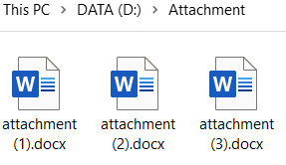
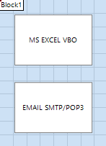
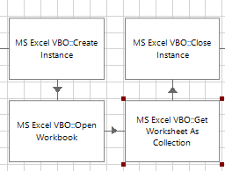






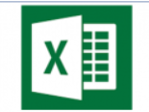
System Architecture
Attachments that need to be send
Object studio
Process studio
Email configure
Email SMTP to send message
Run the process
Import MS EXCEL VBO AND EMAIL SMTP
Actions to be done with MS EXCEL VBO
Email send to bunch of people with attachment
Store emails in excel sheet
User email and password

Slide 8
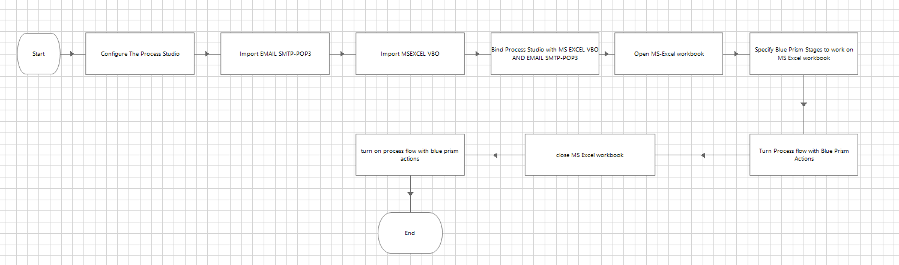
Project Implementation
Block Diagram

Slide 9
Hardware and Software Requirements
Hardware requirements :
-Administration access to install and run Blue Prism.
-Minimum 10GB free disk space.
-Windows 8.1 or 10 (64-bit version only) OR Cloud: Get started free, *Cloud account required.
-Minimum System Requirements To run Office Excel 2013, your computer needs to meet the following minimum hardware requirements:
● 500 megahertz (MHz)
● 256 megabytes (MB) RAM
● 1.5 gigabytes (GB) available space
● 1024x768 or higher resolution monitor
Software requirements:
-Blue Prism software
- Microsoft Excel 2013

Slide 10
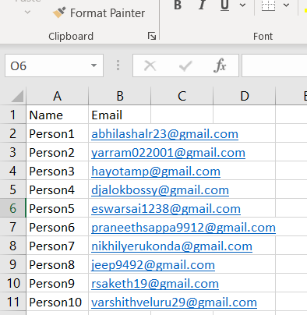
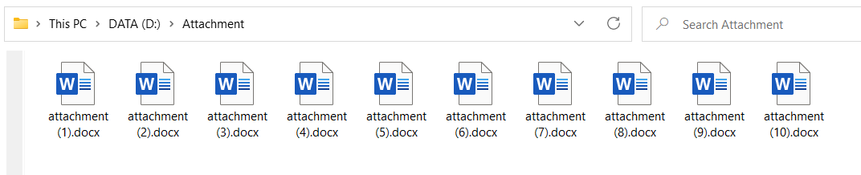
Construction
Note:
First store the name and email address
of the people in Microsoft Excel sheet
With name Email attachment.
Store the attachments in a folder name as Attachment to add in email.

Slide 11
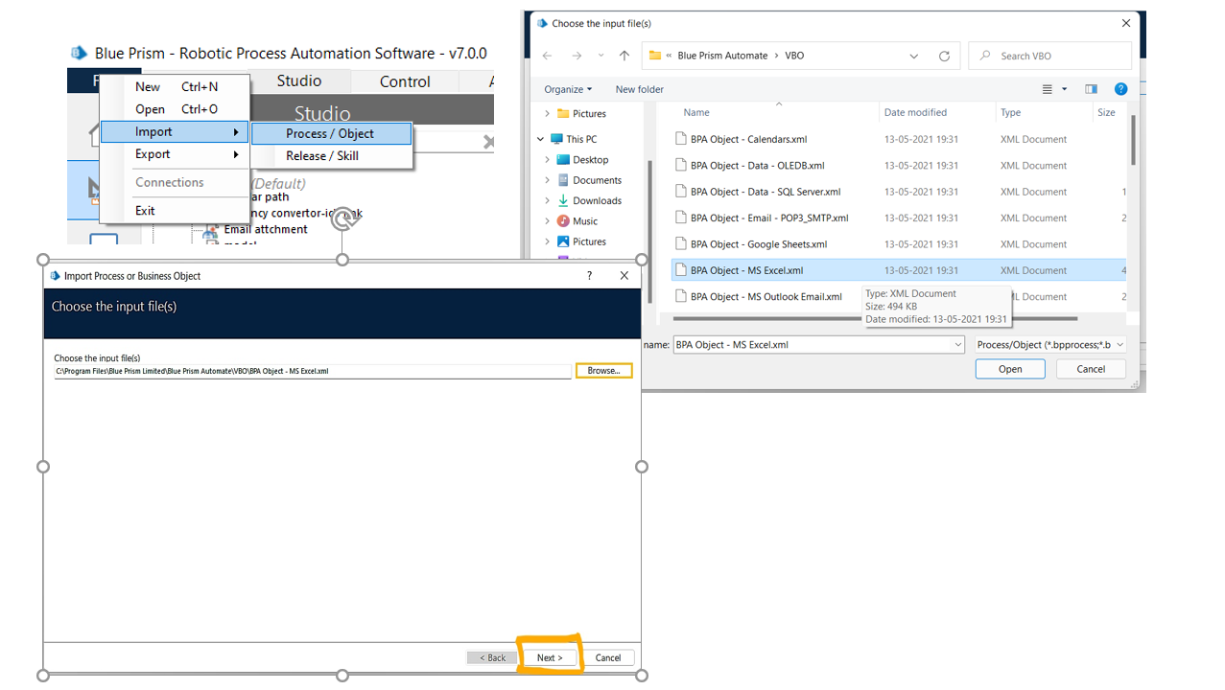
ACTIVITY 1:We have to import MS EXCEL VBO and EMAIL SMTP into the Blue Prism.
Step:1
MS EXCEL VBO Click on file->Then on import->then Process/Object->Browse-> (C:\Program Files\Blue Prism Limited\Blue Prism Automate\VBO\BPA Object - MS Excel.xml) ->click Next->Then Finish.

Slide 12
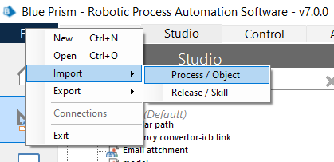
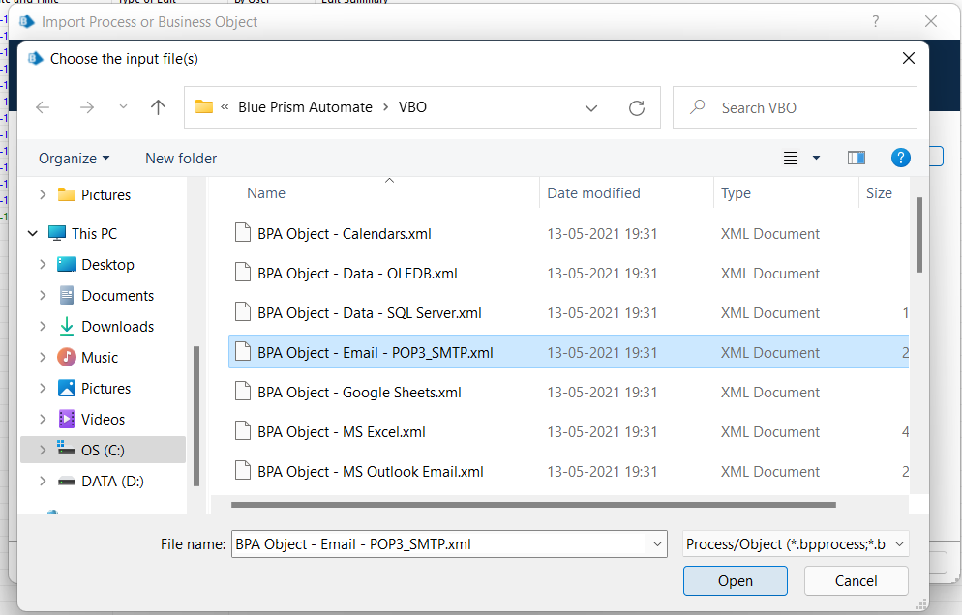
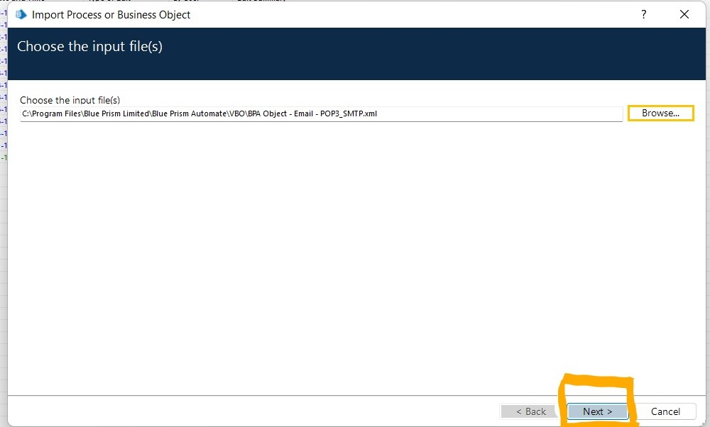
Step 2: Import EMAIL POP3/SMTP
Click on file->Then on import->then Process/Object->Browse-> (C:\Program Files\Blue Prism Limited\Blue Prism Automate\VBO\BPA Object – Email- POP3_SMTP.xml) ->click Next->Then Finish.

Slide 13
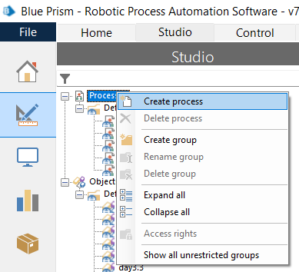
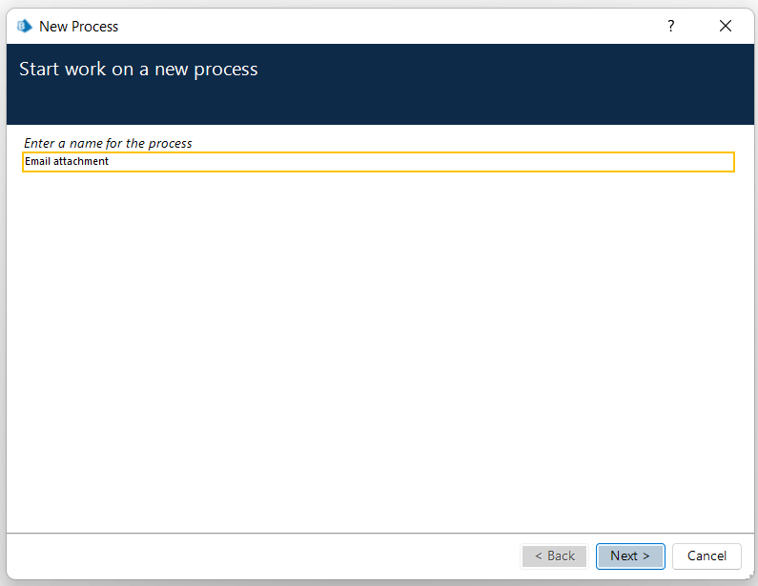
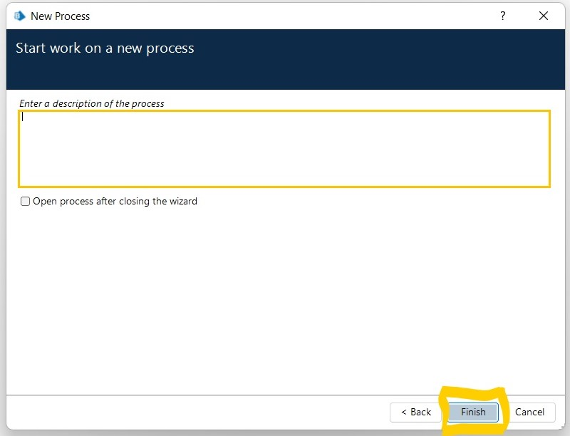
ACTIVITY : 2
Step 1: create a process
After launching the Blue Prism, Open Studio tab, right-click on process, and select Create process. Give the name as Email attachment then click next and then finish. The screenshots clearly explain the process of creating process.

Slide 14
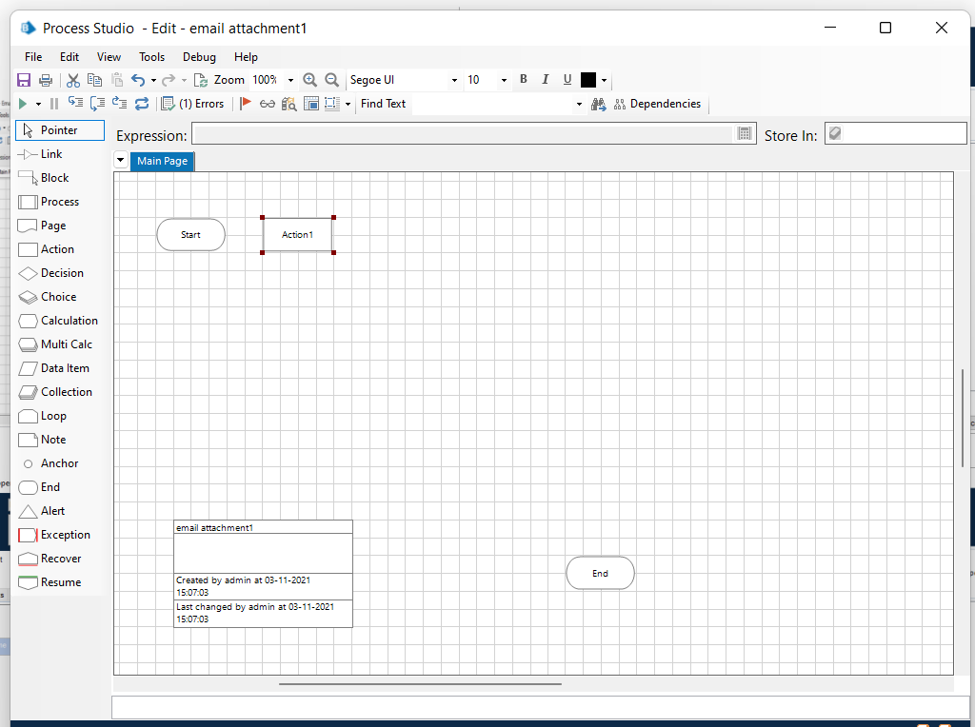
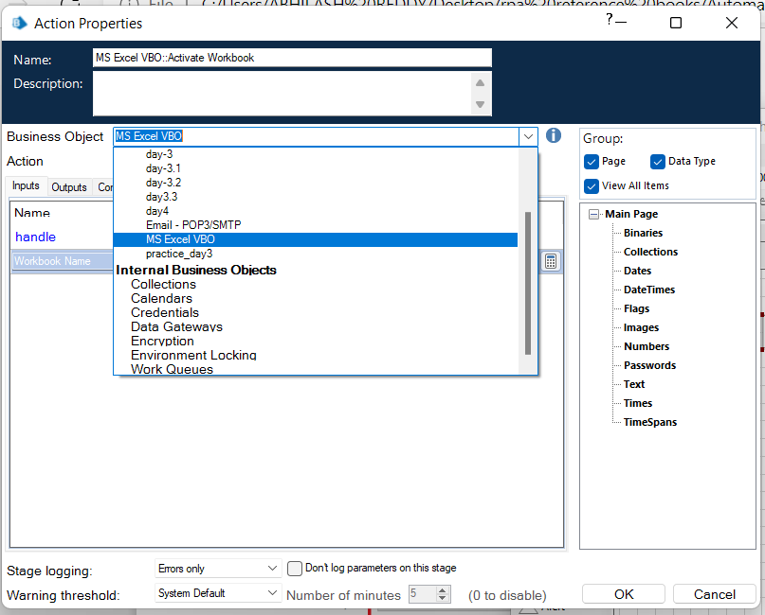
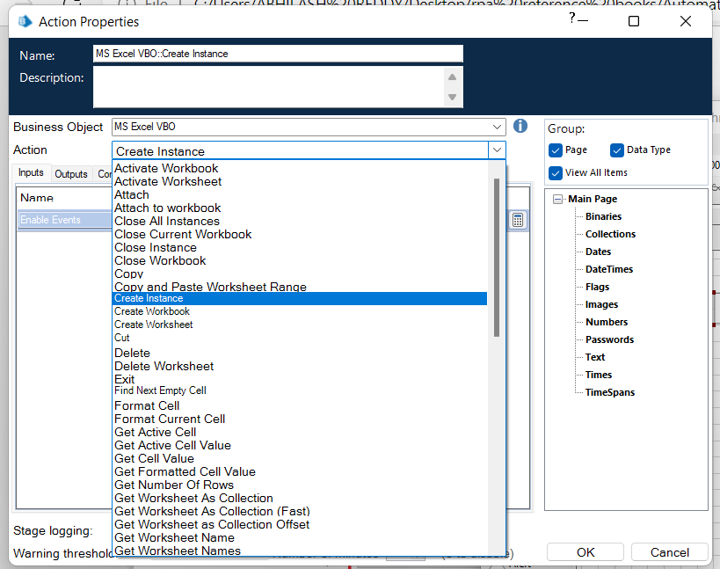
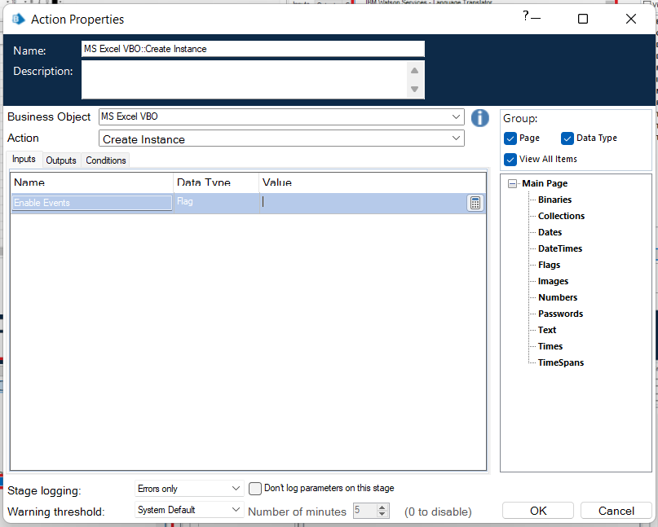
Step 2:
Create an action stage, select MS Excel VBO from Business object drop down, select Create instance action. Create Data Item as follows, • type = number, • name =” handle”.

Slide 15
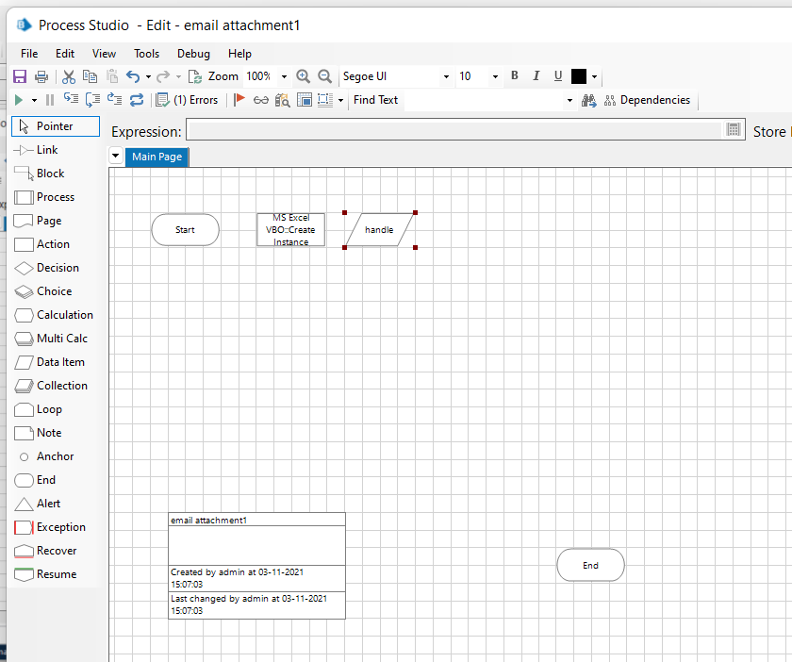
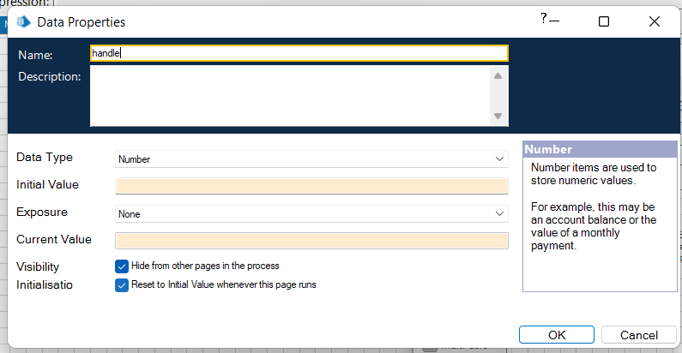
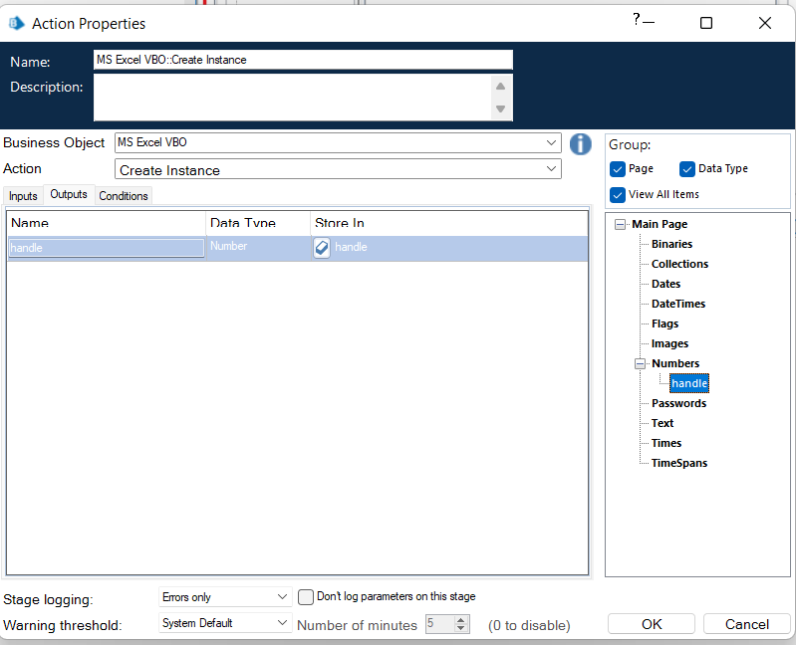
Create Data Item as follows, • Data type = number, • name =” handle”.
Go to output tab and drag handle into Store In column,
click on ok.

Slide 16
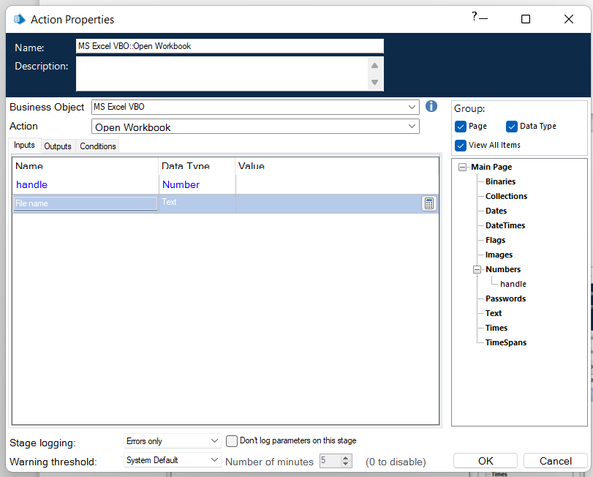
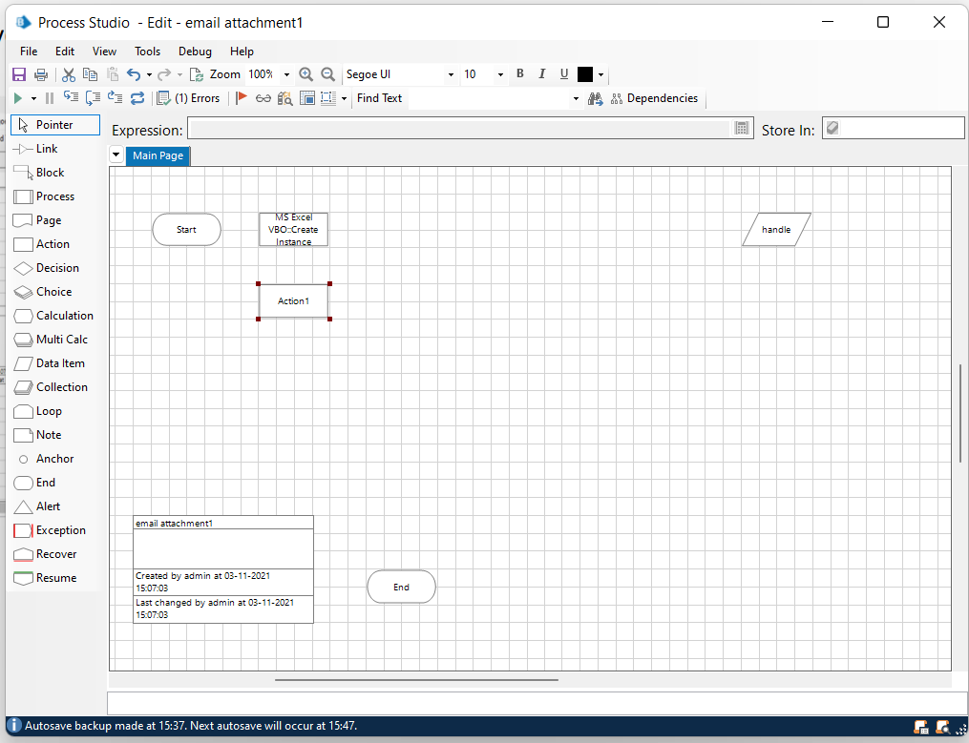
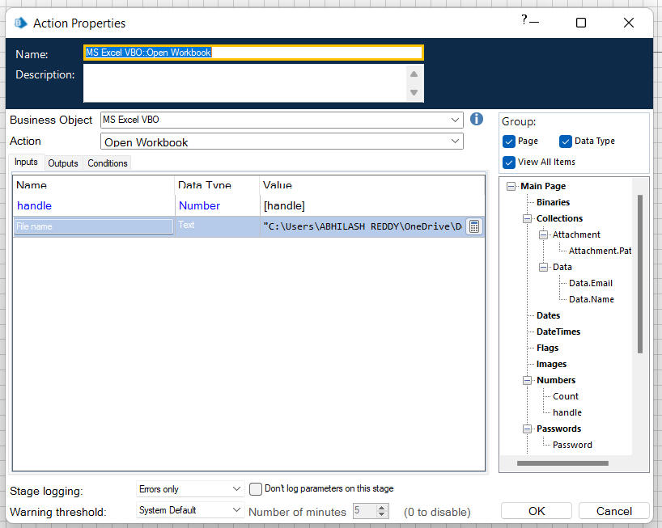
Step 3:Create an action stage, select MS Excel VBO from Business object drop down, select Open Workbook action.
in the input tab give the handle and path of the excel
file.

Slide 17
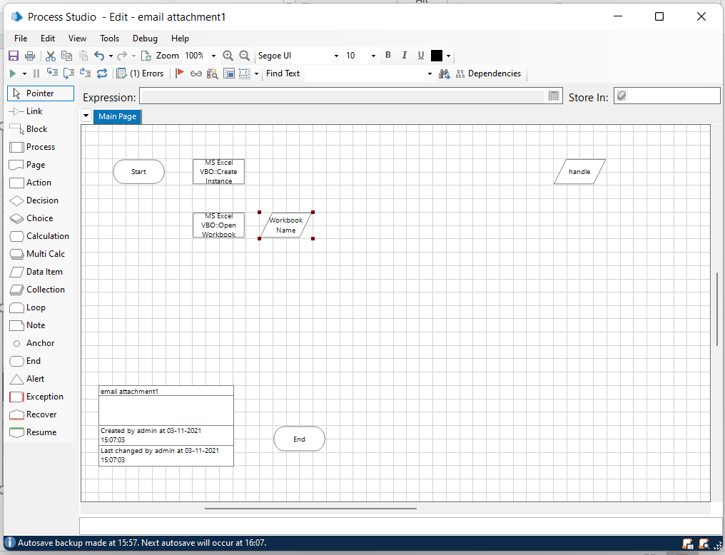
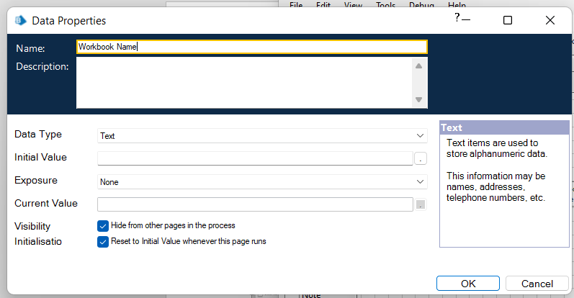
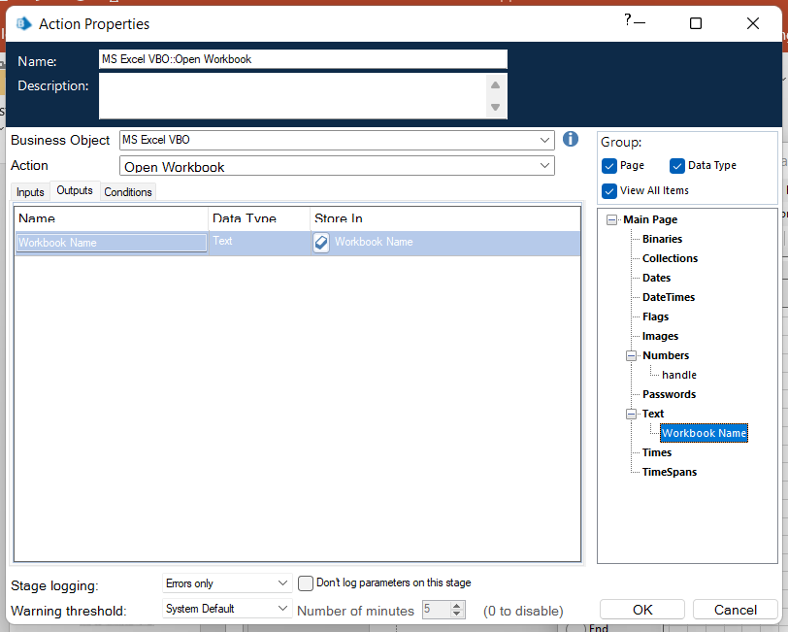
Create Data Item as follows, • type = text; name =” Workbook name”.
Go to output tab and drag Workbook name into Store in column, click on ok.

Slide 18
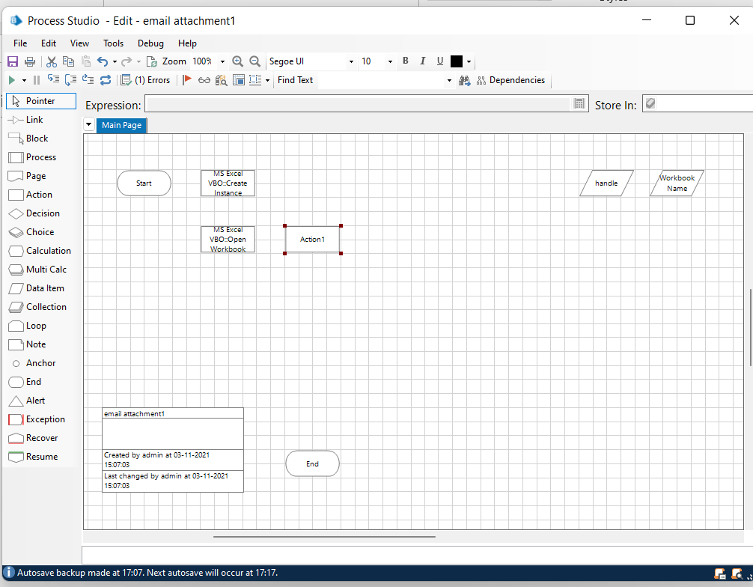
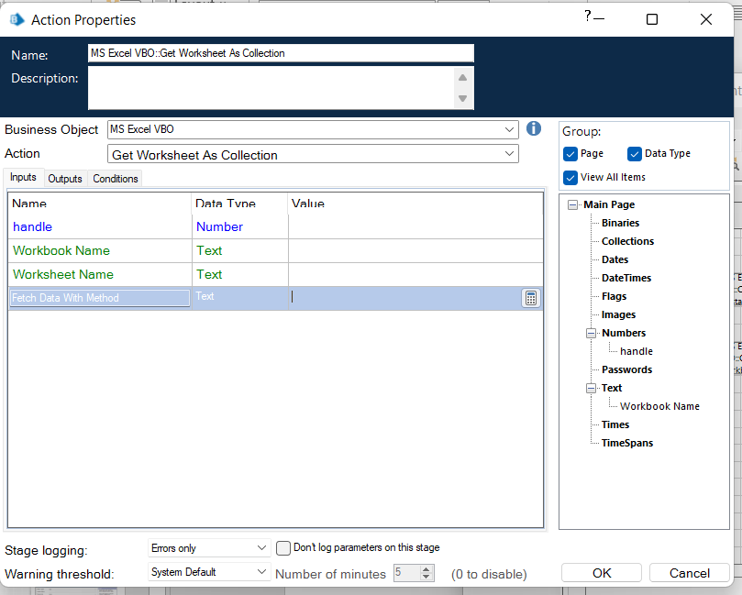
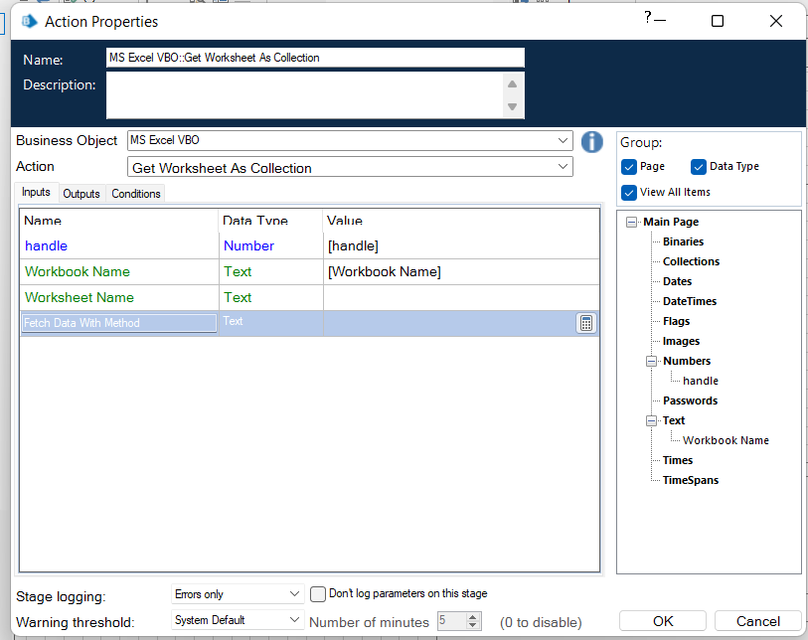
Step 4: create an action stage ,select MS Excel VBO from business object drop down, select Get worksheet as collection
In the input tab give the handle and workbook name.

Slide 19
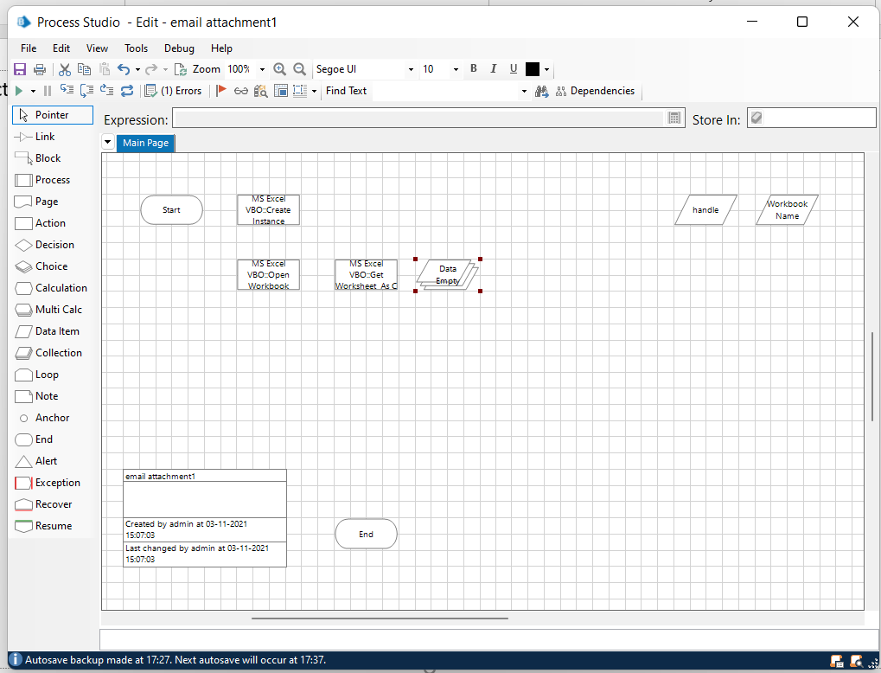
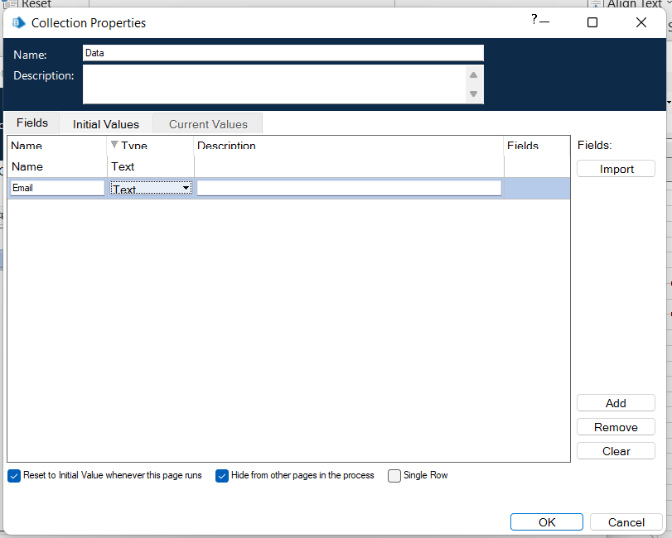
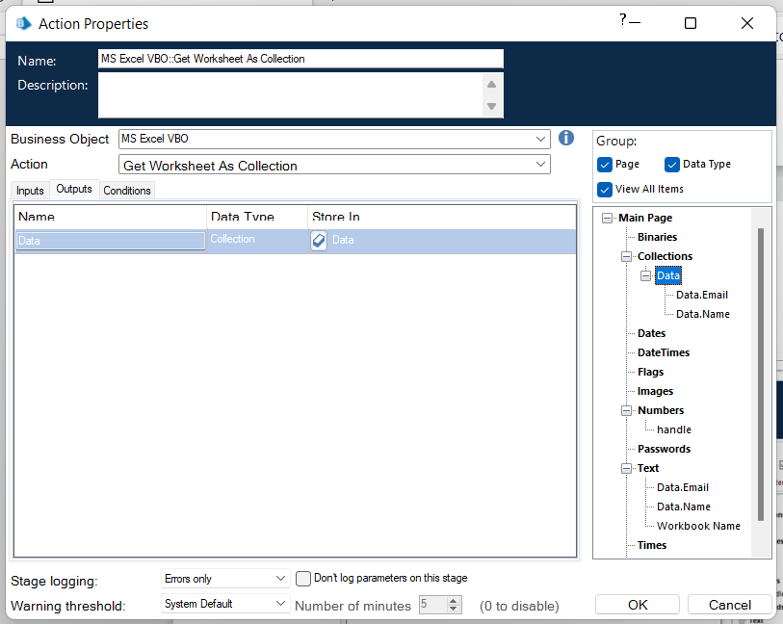
Create Collection,and click on add with fields as follows, • type = text; name =” Name” • type = text; name= “Email”.
Go to output tab and drag Data into Store in
column, click on ok.

Slide 20
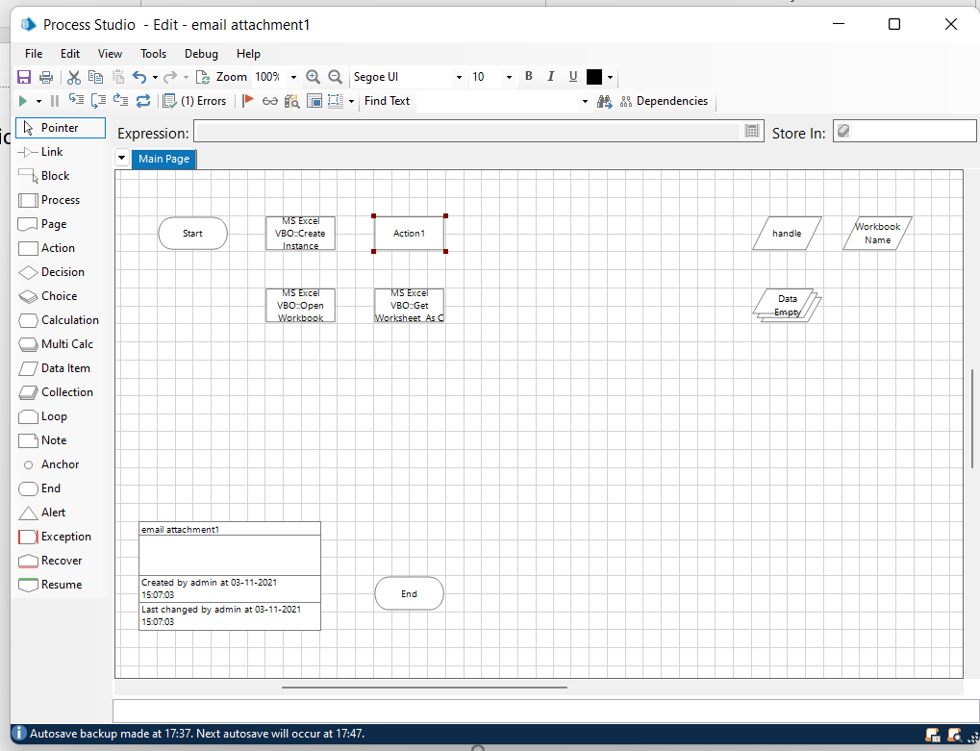
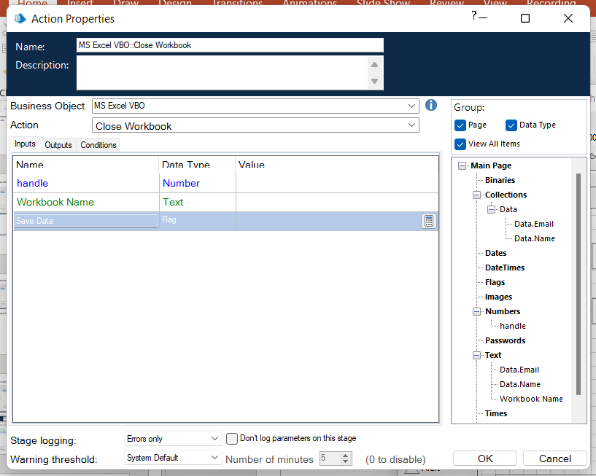
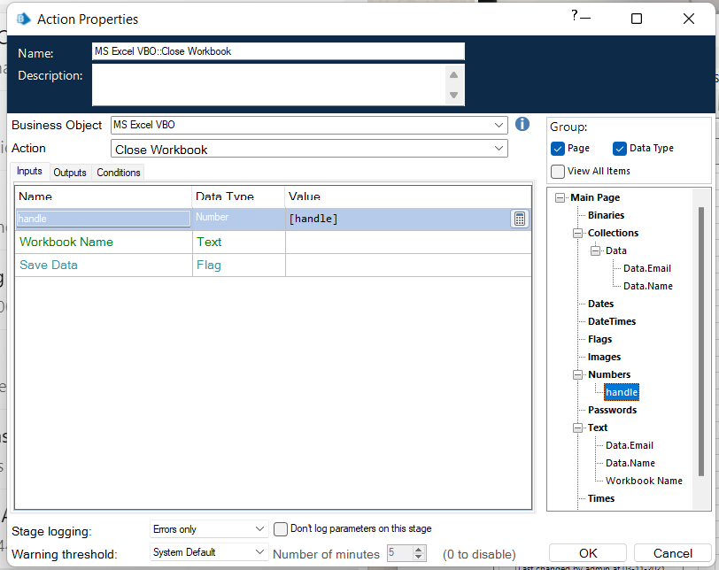
Step 5:
Create an action stage, select MS Excel VBO from Business object drop down, select Close Instance action.
Drag and drop the handle, click on ok.

Slide 21
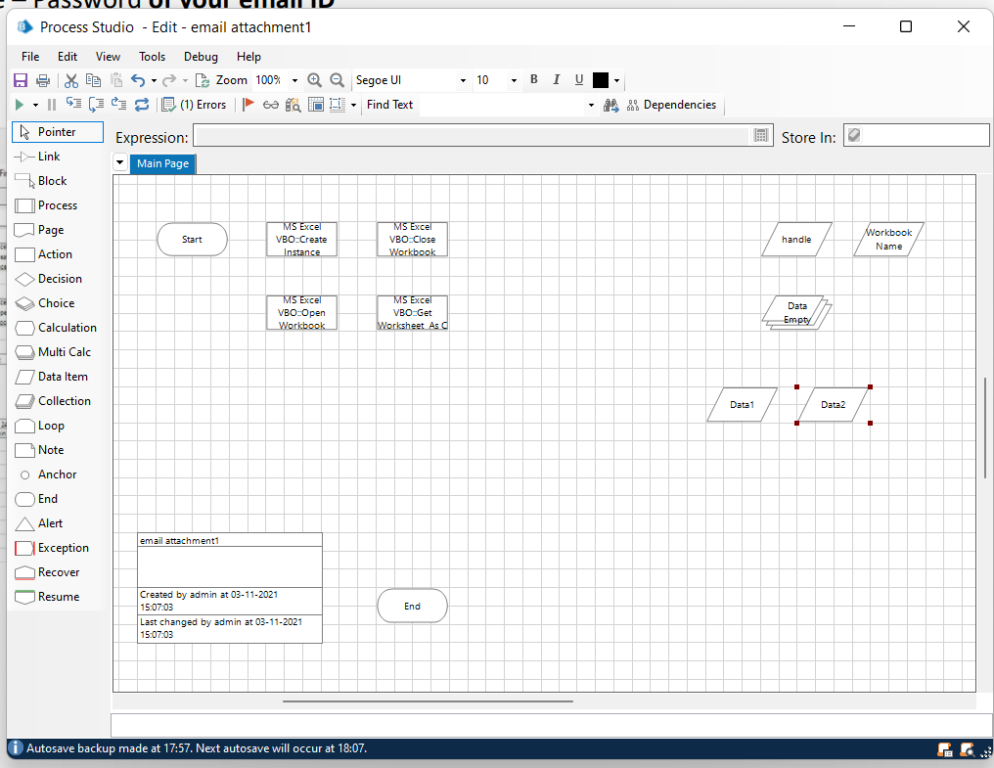
Step 6:
Add two data items one for Email and other for Password.
To store the Email
• Name – Email
• Type – Text
• Initial value – Your email ID
2. To store the Password
• Name - Password
• Type – Password
• Initial value – Password of your email ID

Slide 22
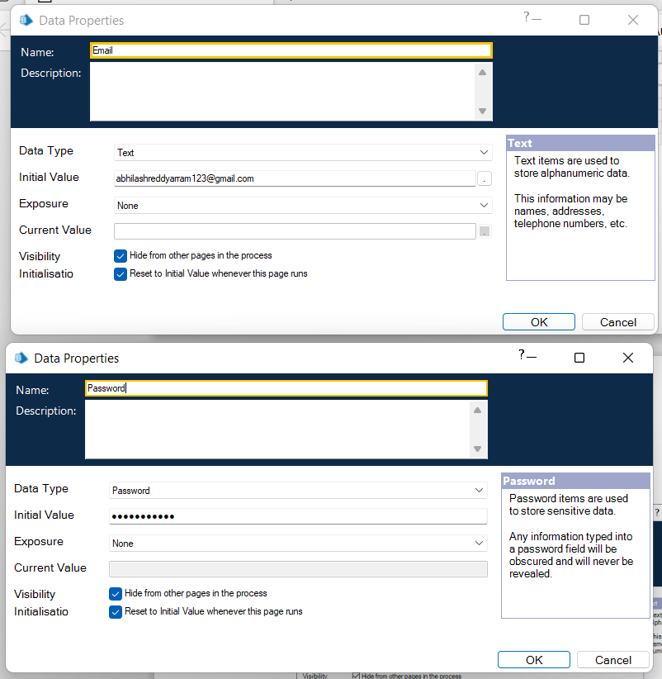

Slide 23
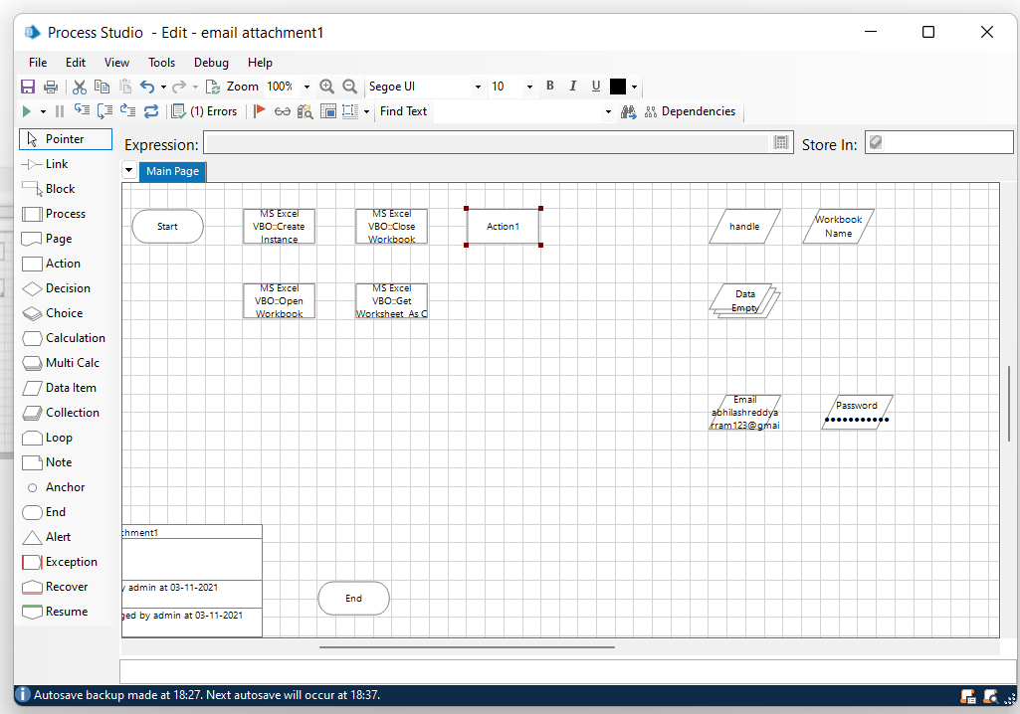
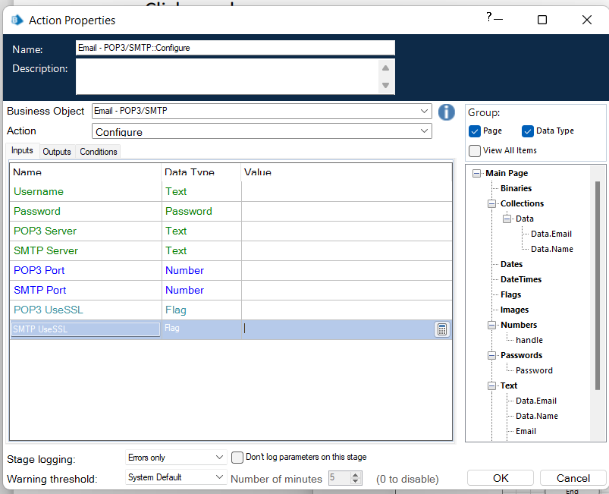
Step 7:
Create an action stage, select Email VBO from Business object drop down, select Configure action.

Slide 24
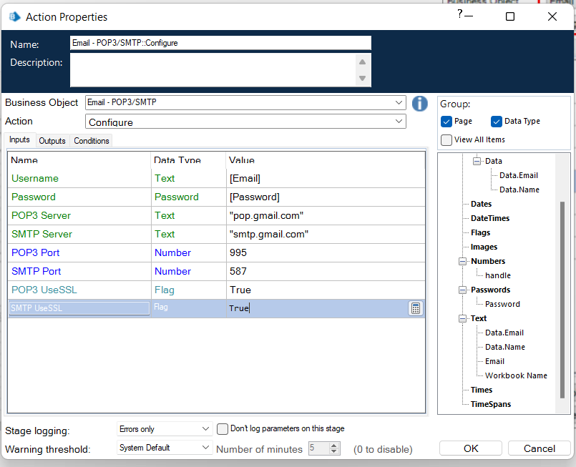
In the input tab drag the Email and Password and the give the following details:
• POP3 Server = "pop.gmail.com"
• SMTP Server = "smtp.gmail.com"
• POP3 Port = 995
• SMTP Port = 587
• POP3 UseSSL = True
• SMTP UseSSL = True

Slide 25
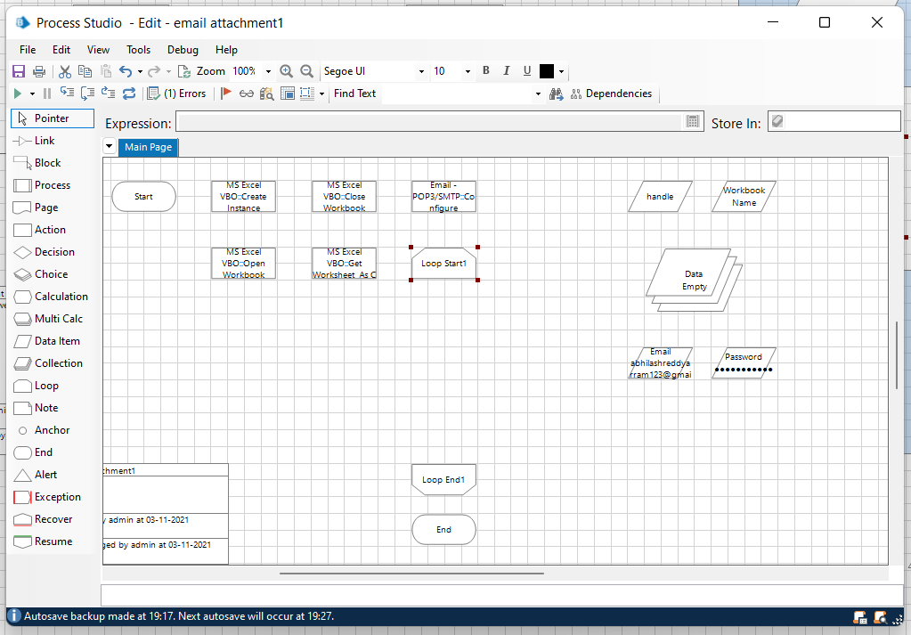
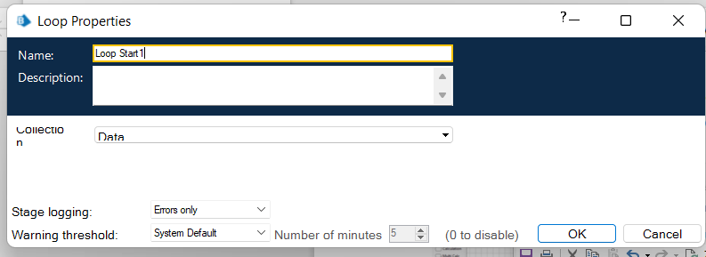
Step 8:Add a loop stage and make it to loop for Data collection.
Drag and drop a loop stage and change the arrangement of all the stages in the page, double click on it and in the collection drop down select data collection and click ok.

Slide 26
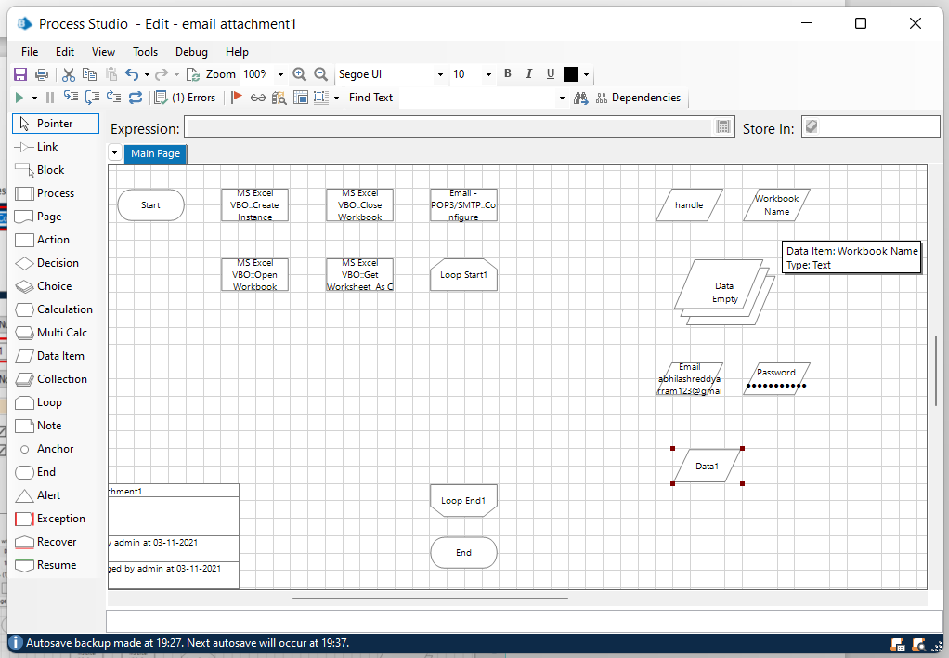
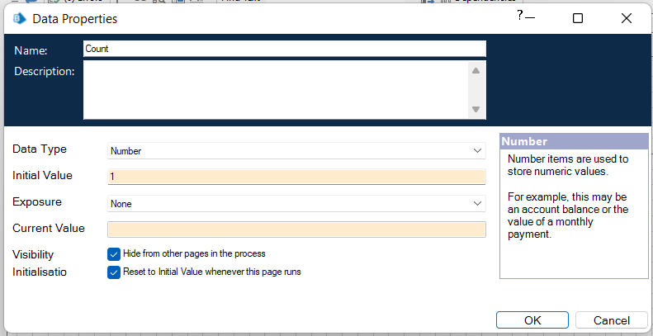
Step 9:Add two data items
Data item 1
To store the number to increment the path for each
attachment
• Name – Count
• Type – Number
• Initial value – 1

Slide 27
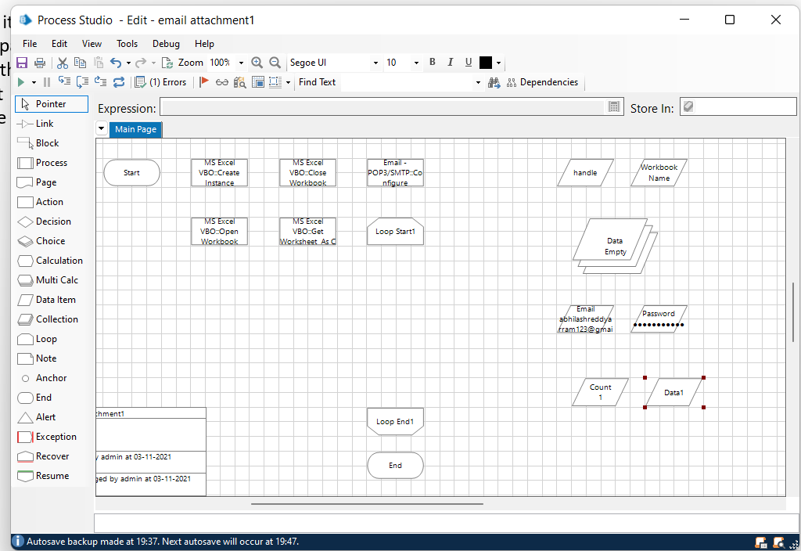
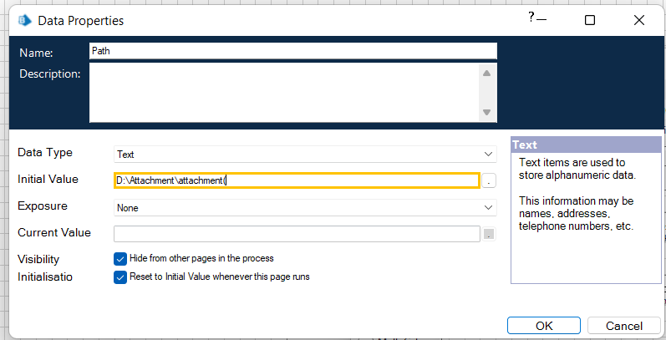
Second data item
To store the path of the attachment (only the constant path. For the numerical part we will be using calculation stage.
• Name – Path
• Type – Text
• Initial value – constant values in the attachment
path.

Slide 28
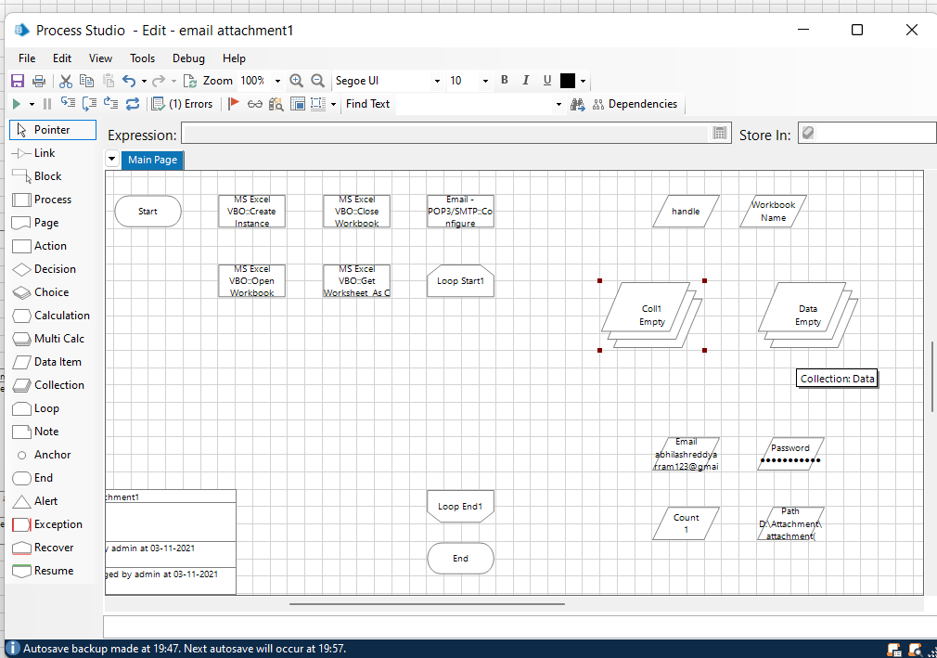
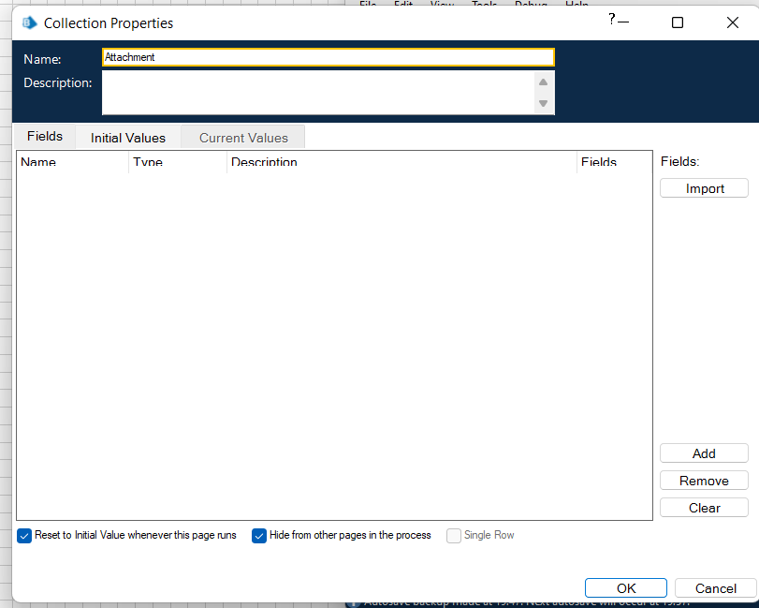
Step 10:
drag and drop a collection, rename it as Attachment

Slide 29
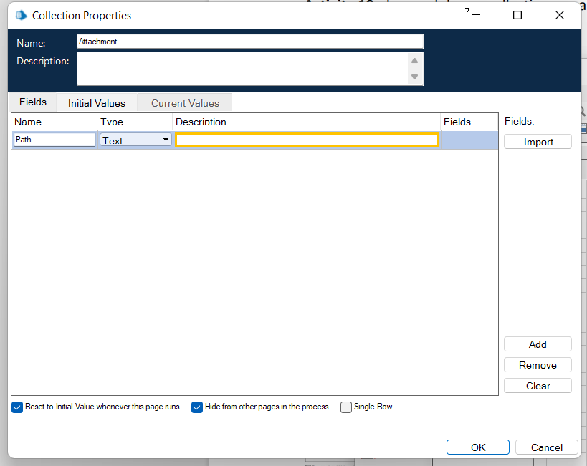

give the following as initial fields
Name – Path;
type – Text
Create a row in initial values column.

Slide 30

Step 11:
Add a multi calculation stage to store the path to Attachment collection and to calculate path.
Drag and drop a multi calculation stage
double click on it and add the following:
• Calculate the path and store it in Attachment collection.
• Increment count.

Slide 31




Slide 32


Step 12:
Create an action stage, select Email SMTP from Business object drop down, select Send message action.

Slide 33

In the input tab give the following details:
• From = Email data item
• To = Email from data collection
• Subject = The subject you want to send
• Body = The body you want to send
• Attachment = Attachment
collection
Click on ok

Slide 34

Step 13:
Link all the stages and run the bot at different timings to notice getting login to different classes. Do Proper connections (Links).

Slide 35
Measurement and Analysis
One of the first desires that probably comes to mind is efficiency.When building your app,you want to be able to reach as many people as you can.You also want to reach them on a consistent basis in a way that doesn’t involve you spending all your time sending emails to everyone.
This method is much more implemented day by day and used in daily life.
It will reduce the potential for errors.
Interpretation of Results
Email automation is a powerful marketing automation tool that lets you send the right message to the right people at the right time.
Can produce the accurate results without any deviation in terms of quality it gives the perfect output.

Slide 36

Methodology
Agile methodology is generally used in this project.

Slide 37
Plan:
At first we need to plan what are the necessary requirements,software in it and to excute the process what are the steps we have to do.
We need to lanch blue prism software in our pc.
We need to import the necessary modules like MS EXCEL VBO and Email SMTP into blueprism.
Design:
Tuning process studio with specific needs and working with different stages in process studio.
Finally building a bot that automatically send mails with attachments to a list of people with the help of Microsoft Excel 2013 and Blue prism.
Develop:
We need to develop all the stages in this and all the necessary requirements whether they are suitable in our project or not.
Selecting different stages with suitable actions make the entire project most efficient.

Slide 38
Test:
After completion of develop stage click on refresh button and test the entire process by clicking on run button.
Check the results if we want any correction in the results just go to develop stages and modify the stages to get the perfect output.
Deploy:
In this stage it runs after one or more evolutionary development phases to put the latest increment in the entire process.
We need to update our process to get an efficient answer according to the specific needs.
Review:
The entire project has to be reviewed and get feedback from the people who are using this.
Finally we have to launch the project.

Slide 39

Results and Discussion
Click on reset button to refresh and click on run button to start the process and when the process end it shows as completed and we get the results in the below pictures

Slide 40

From the above diagram we get the mails are sent successfully from my mails to the list of people with attachment that present in the excel sheet.when the loop starts with the attachment each and every attachment is sent to respective email id.This process makes accurate results without any errors.When the entire process end and comes to end stage the process shows as completed.

Slide 41
Conclusion
From this project we get to know that RPA is very important for any other developments also in day to day activities.
This RPA process is rapidly increasing technology and the implementation was simple and easy.
From this technology we can save time and it is measurable and accuracy is perfect.
Email workflow is that it works its magic all on its own. After they're set up, you can choose a specific criteria to trigger the workflows and off they go.You don't need someone to click send. You can rely on the email automation to work 24/7.

Slide 42
You don't need a large sales team making cold calls every day. They can approach people when they're ready to be contacted and you don't need additional admin teams ensuring emails are sent out regularly. Paying for a large team to constantly contact prospects isn’t needed. Also, you don’t need to be tech-savvy to use marketing automation, meaning that even less-experienced marketers can manage workflows.
On coming to this project as discussed in project objective’s and scope.I came to learn implementation of those in a better way .
In future there will be many development takes place under this email automation.Email marketing can be further develop by this technique.this email is the top jen tool used by 90 % of the population.
It was a well and good experience with the entire course and I have gained a lot of knowledge from this.

Slide 43
References
[1] [2] [3] [4] [5] | IRPAAI, “Robotic Process Automation in the Real World: How 3 Companies are Innovating with RPA,” 2018.s S. Anagnoste, "Robotic Automation Process-The next major revolution in terms of back office operations improvement." In Proceedings of the International Conference on Business Excellence, vol. 11, no. 1, pp. 676686. De Gruyter Open, 2017 A.Asatiani, and E. Penttinen, “Turning Robotic Process Automation into Commercial Success - Case Opus Capita”, Journal of Information Technology Teaching Cases: PP .1–8, 2016. Y.A.Kumar, G. Raghavendra,” The Pioneers of Robotic Process Automation (RPA) Software”, International Journal of Scientific Research in Computer Science, Engineering and Information Technology , Vol 3 , Issue 4 , PP. 96- 100 ISSN : 2456-3307. M. C. Lacity, and L. P. Willcocks, (2016)” A new approach to automating services”. MIT Sloan Management Review, Fall. ISSN 1532-9194

